Slide 1
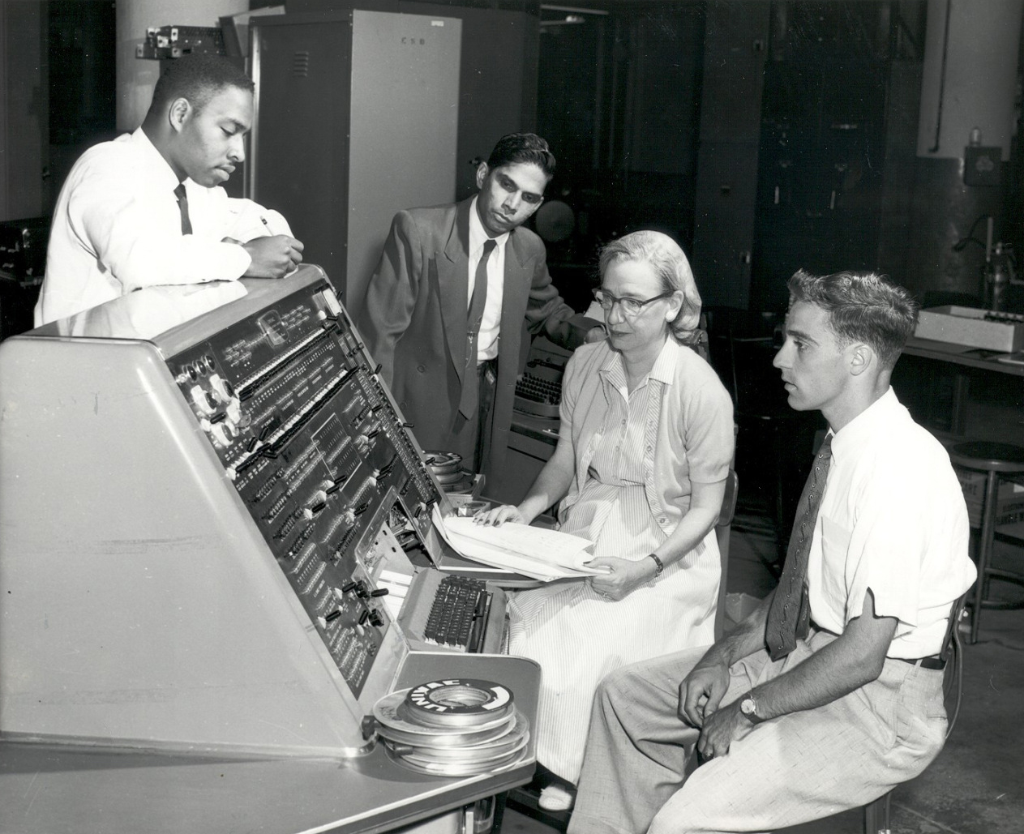

A Brief History of AI
“I propose to consider the question, ‘Can machines think?’ This should begin with definitions of the meaning of the terms ‘machine’ and ‘think’”
- ALAN M TURING (1950)
This lecture traces the remarkable journey of Artificial Intelligence (AI), from its conceptual roots in the 19th century to its transformative impact and future potential in the 21st century.

Slide 2
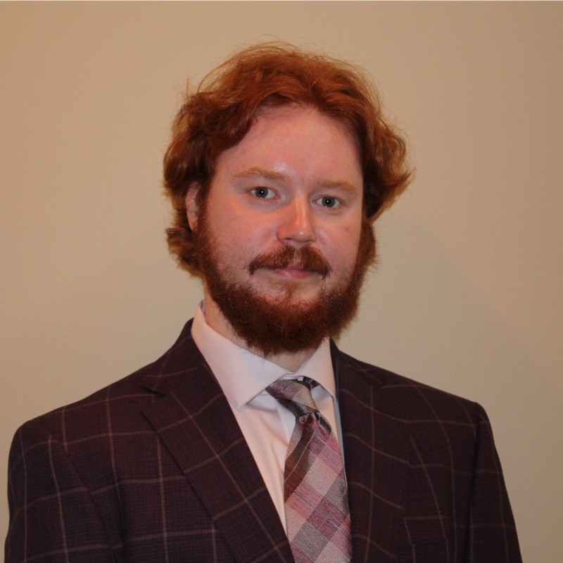
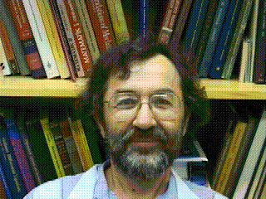
Collin Connors
University of Miami / ERMProtect
cdc104@miami.edu
Hüseyin Koçak
University of Miami
hk@cs.miami.edu
This is necessarily a brief and select collection of episodes in the rich history of AI. Apologies for inevitable omissions. If we missed your favorite moment in AI history please let us know.

Slide 3
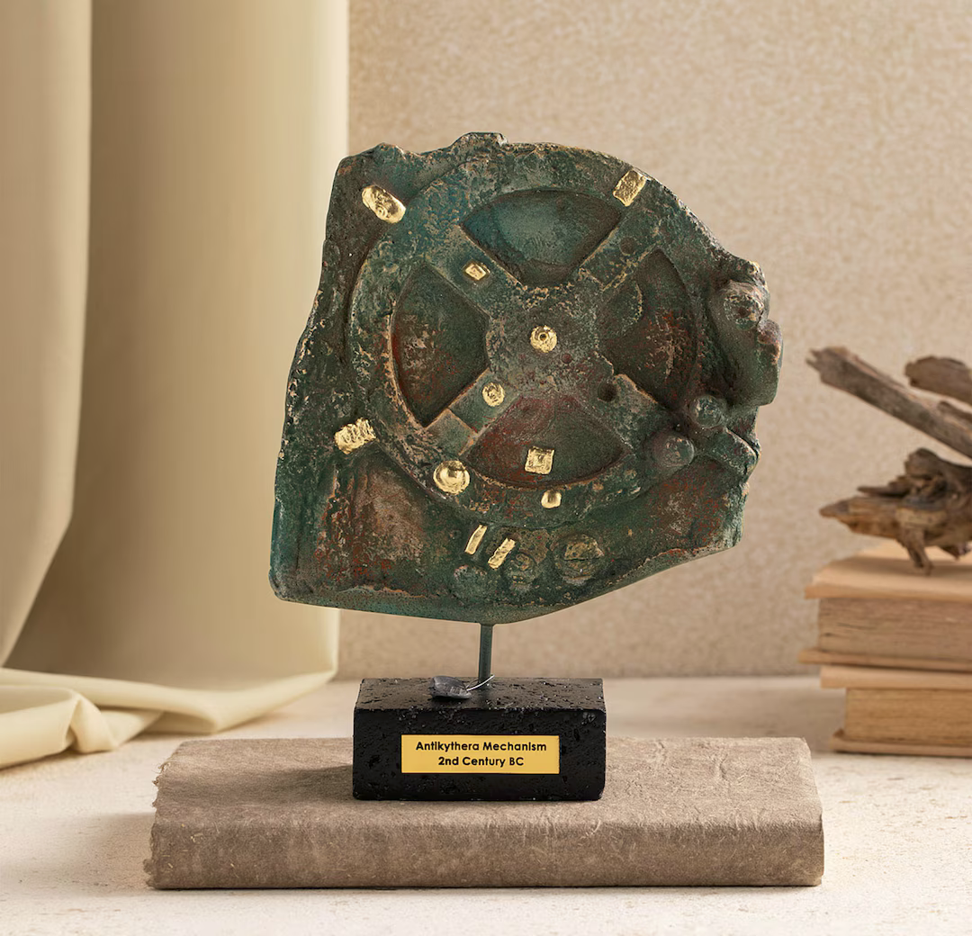
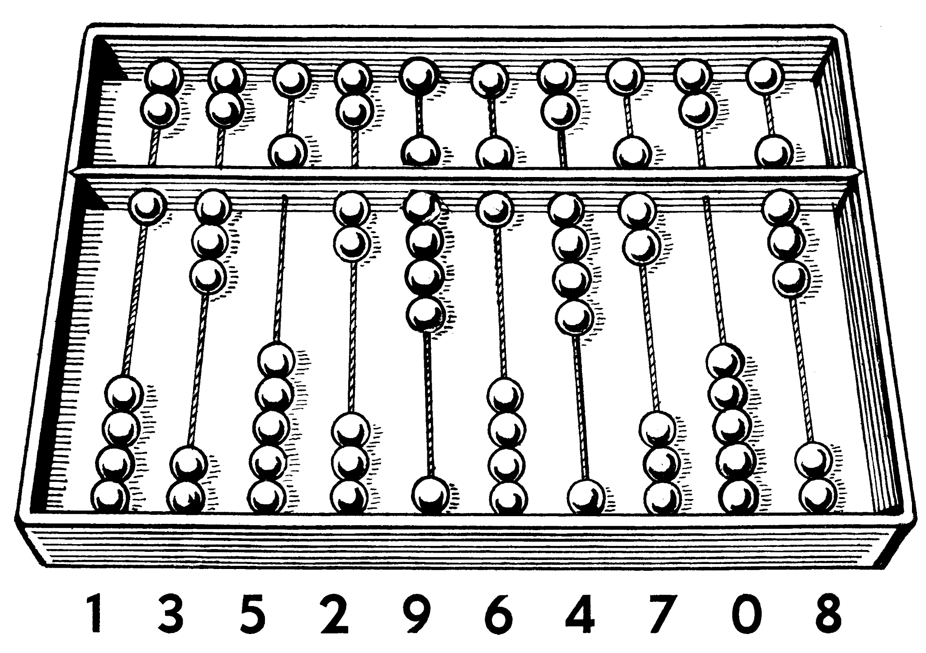
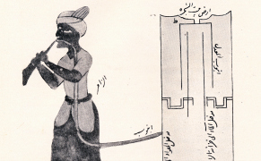
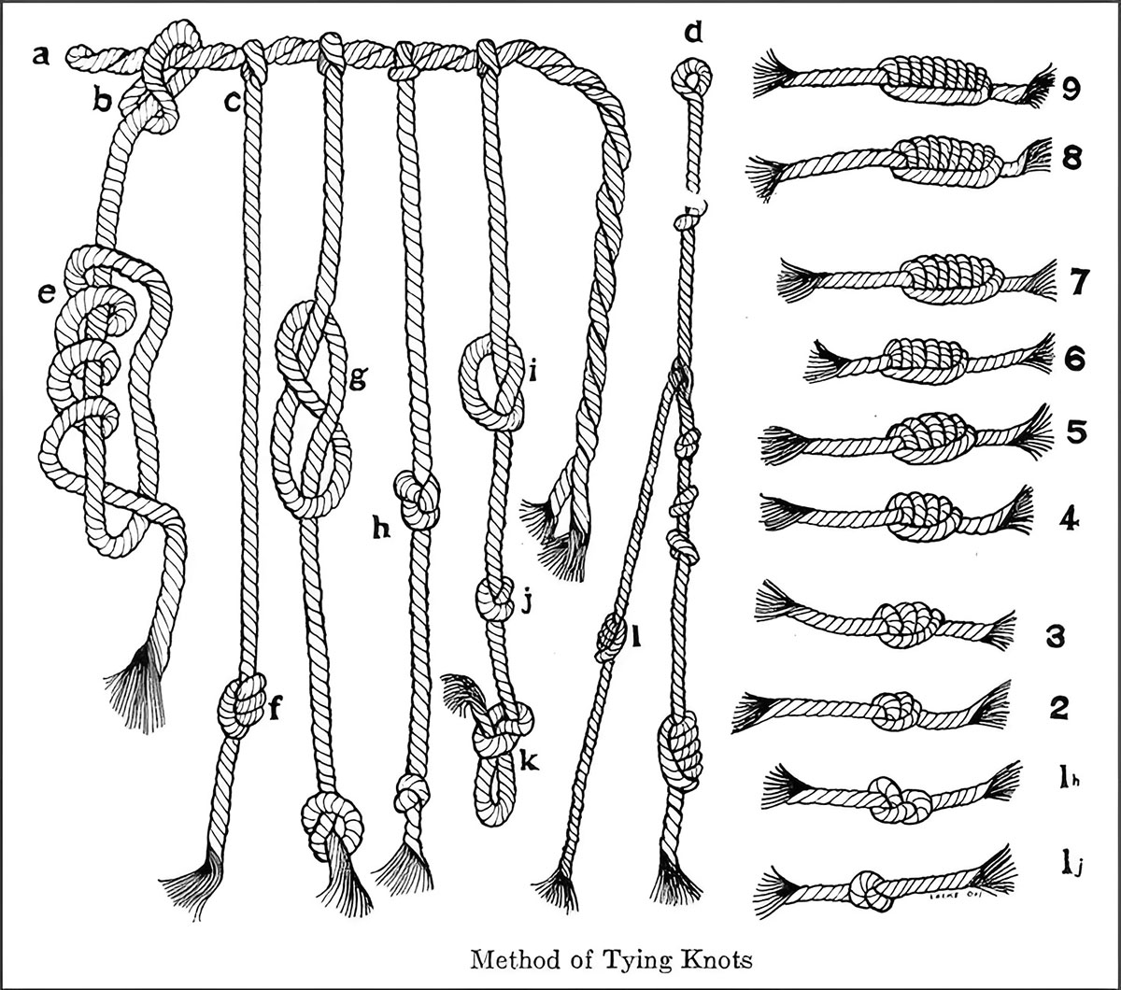
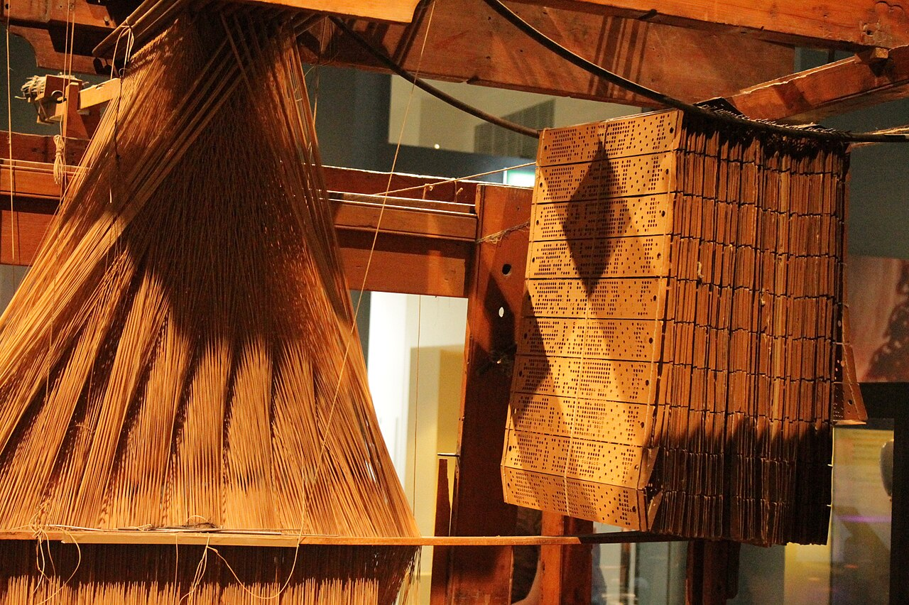
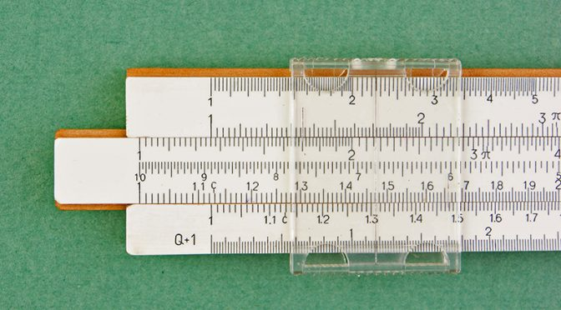
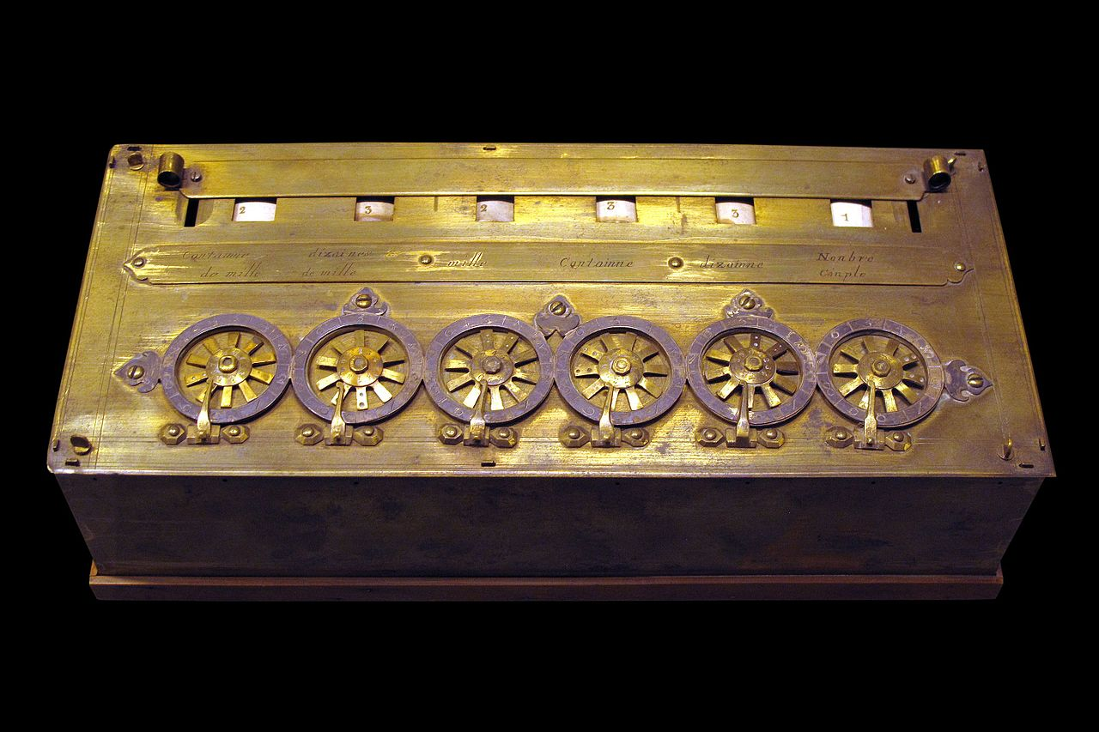
Early Computing Machines

Slide 4
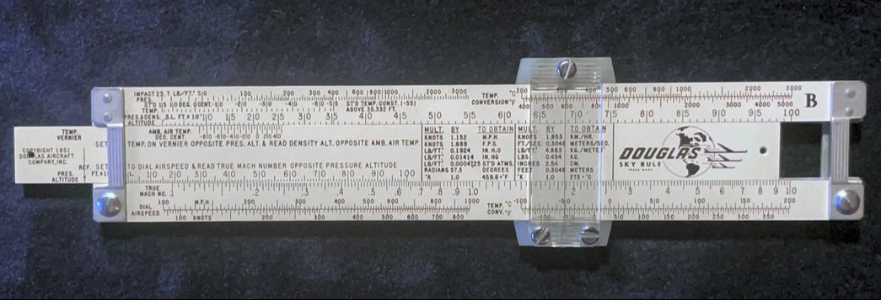
Slide Rule

Slide 5
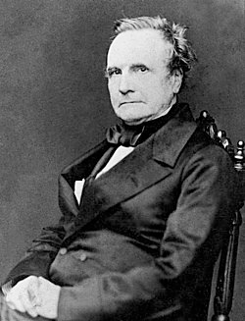
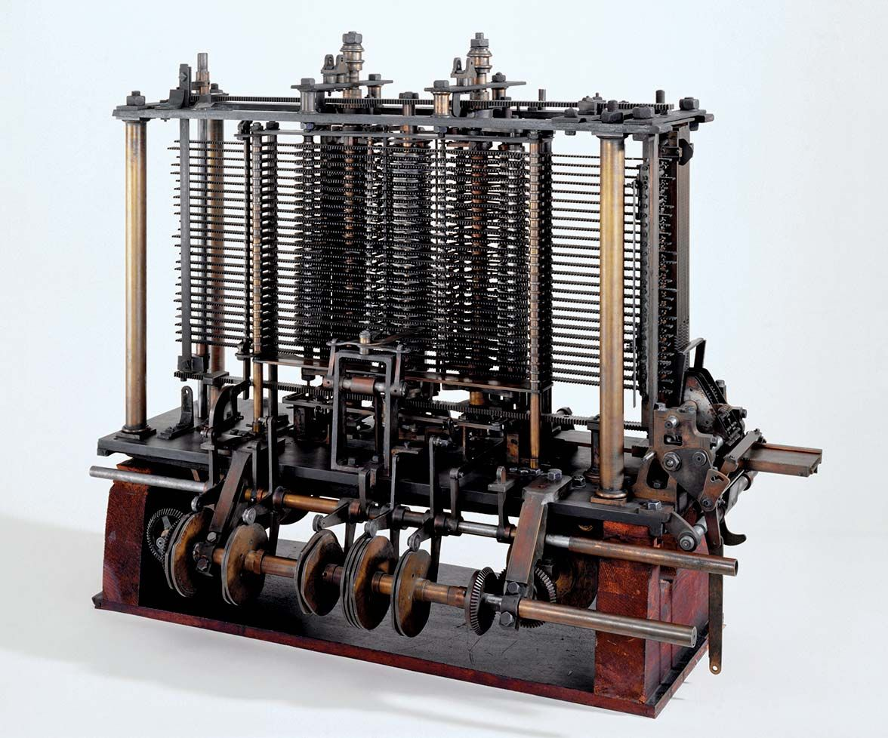
Charles Babbage and The Analytical Engine – 1830’s
English Mathematician and Inventor
Created what has since become known as the first computer called the Analytical Engine
Punch Cards for taking input (Computer Program)
Store for storing data (RAM)
Mill for performing computations including loops and branching (CPU)
Output on printers or as impressions into soft material (I/O Devices)
The machine was never built

Slide 6

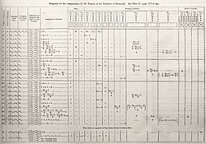
Ada Lovelace, the first Computer Programmer– 1840’s
Wrote a Program to calculate Bernoulli Numbers for the Analytical Engine
First to suggest the use of computers beyond number crunching:
“[The Analytical Engine] might compose elaborate and scientific pieces of music of any degree of complexity or extent”
“The Analytical Engine has no pretensions whatever to originate anything. It can do whatever we know how to order it to perform. It can follow analysis; but it has no power of anticipating any analytical relations or truths.”

Slide 7
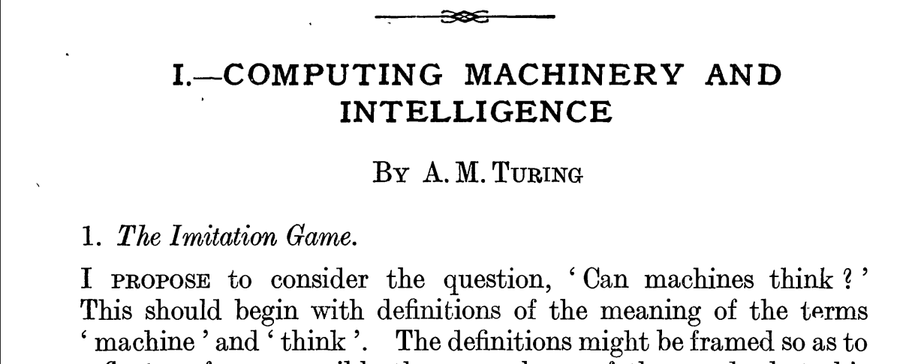
Beyond Lovelace: “A better variant of [Lady Lovelace's objection] says that a machine can never ‘take us by surprise.’ … Machines take me by surprise with great frequency.”
His foresight: “We may hope that machines will eventually compete with man in all purely intellectual fields … We can only see a short distance ahead but we can see plenty there that needs to be done”

Slide 8
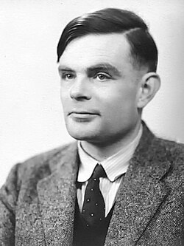
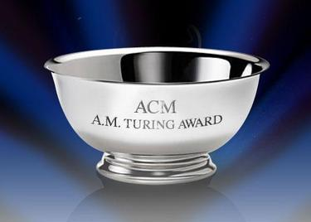
Alan Turing and Dawn of Computer Science – 1950’s
A luminary figure in the creation of modern Computer Science
The most prestigious award in Computer Science is named in his honor with recipients receiving 1 million dollars
Contributions include:
Turing Machines - a universal computer
Breaking the Enigma cipher
Numerical Analysis algorithms
Morphogenesis - systems biology
Computing Machinery and Intelligence

Slide 9
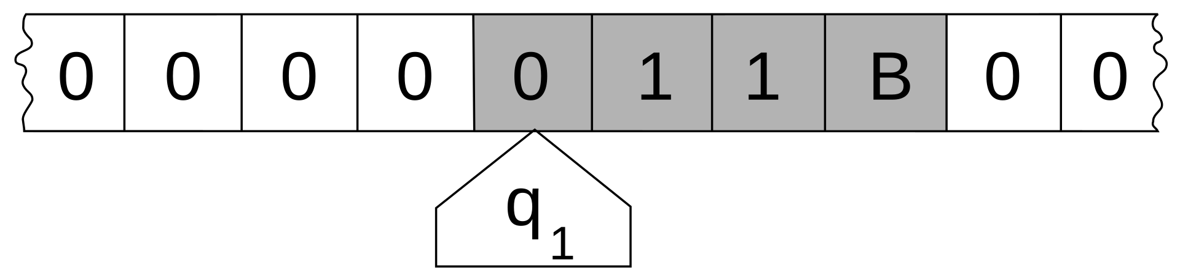
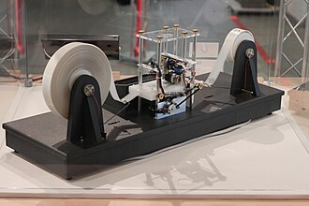
Alan Turing and Dawn of Computer Science – 1950’s
A luminary figure in the creation of modern Computer Science
The most prestigious award in Computer Science is named in his honor with recipients receiving 1 million dollars
Contributions include:
Turing Machines - a universal computer
Breaking the Enigma cipher
Numerical Analysis algorithms
Morphogenesis - systems biology
Computing Machinery and Intelligence

Slide 10
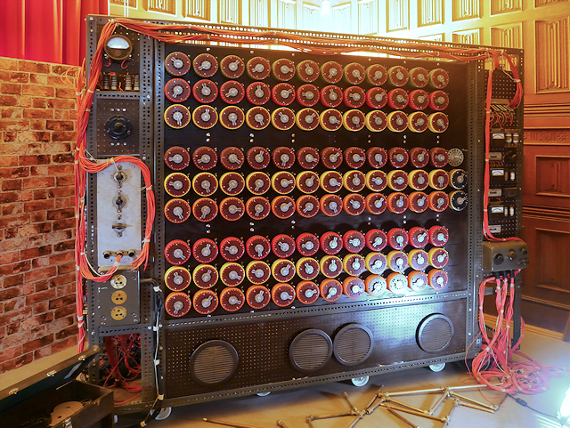
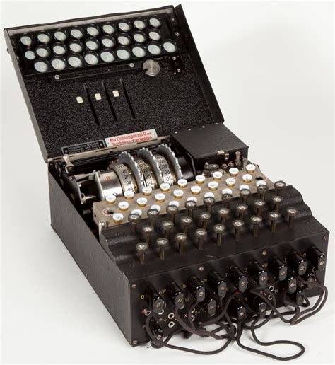
Alan Turing and Dawn of Computer Science – 1950’s
A luminary figure in the creation of modern Computer Science
The most prestigious award in Computer Science is named in his honor with recipients receiving 1 million dollars
Contributions include:
Turing Machines - a universal computer
Breaking the Enigma cipher
Numerical Analysis algorithms
Morphogenesis - systems biology
Computing Machinery and Intelligence

Slide 11
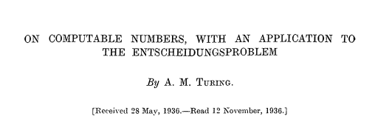
Alan Turing and Dawn of Computer Science – 1950’s
A luminary figure in the creation of modern Computer Science
The most prestigious award in Computer Science is named in his honor with recipients receiving 1 million dollars
Contributions include:
Turing Machines - a universal computer
Breaking the Enigma cipher
Numerical Analysis algorithms
Morphogenesis - systems biology
Computing Machinery and Intelligence

Slide 12
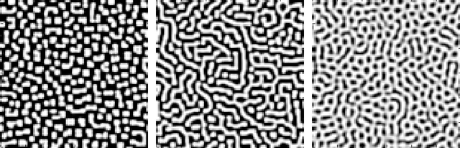
Alan Turing and Dawn of Computer Science – 1950’s
A luminary figure in the creation of modern Computer Science
The most prestigious award in Computer Science is named in his honor with recipients receiving 1 million dollars
Contributions include:
Turing Machines - a universal computer
Breaking the Enigma cipher
Numerical Analysis algorithms
Morphogenesis - systems biology
Computing Machinery and Intelligence

Slide 13
Beyond Lovelace: “A better variant of [Lady Lovelace's objection] says that a machine can never ‘take us by surprise.’ … Machines take me by surprise with great frequency.”
His foresight: “We may hope that machines will eventually compete with man in all purely intellectual fields … We can only see a short distance ahead but we can see plenty there that needs to be done”

Slide 14
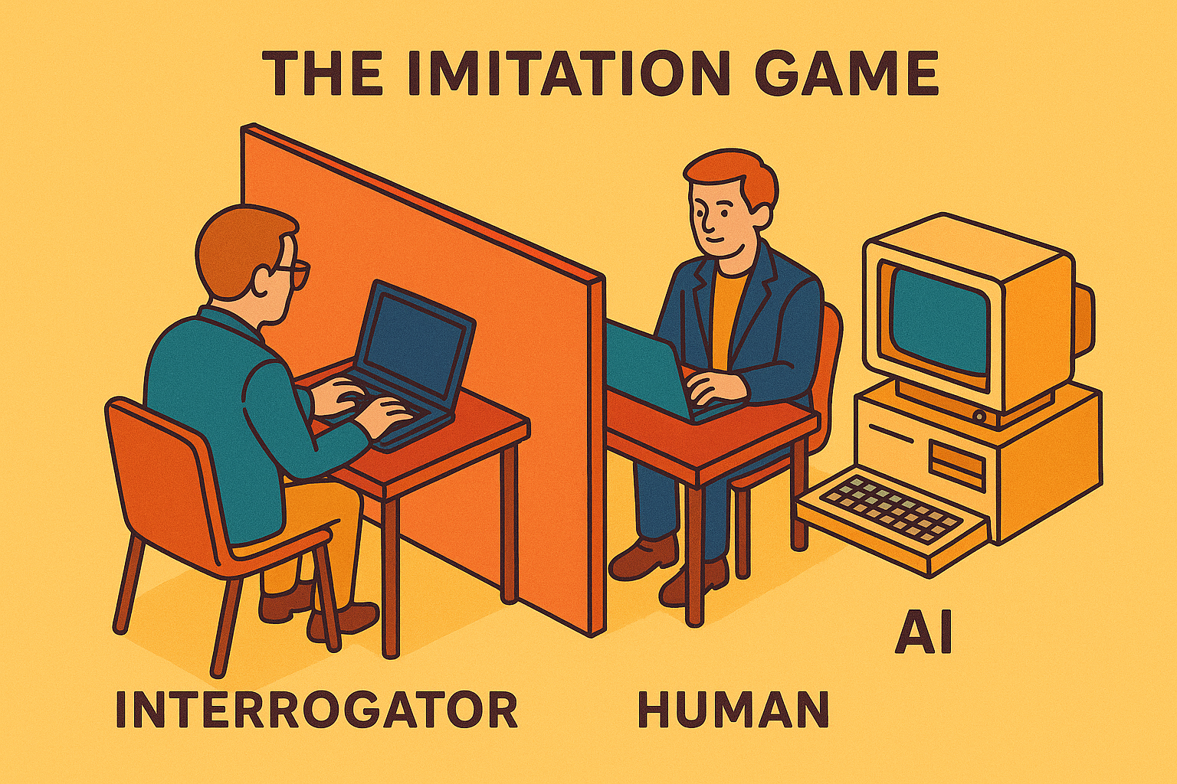
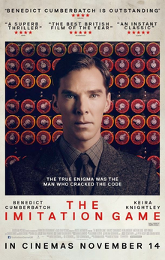
Alan Turing and the Imitation Game – 1950’s

Slide 15
Early AI Landmarks - 1940 – 1955
Cybernetics
Digital brain
Artificial neurons
Biological neurons
Video game
Machine translation
Theorem proving

Slide 16
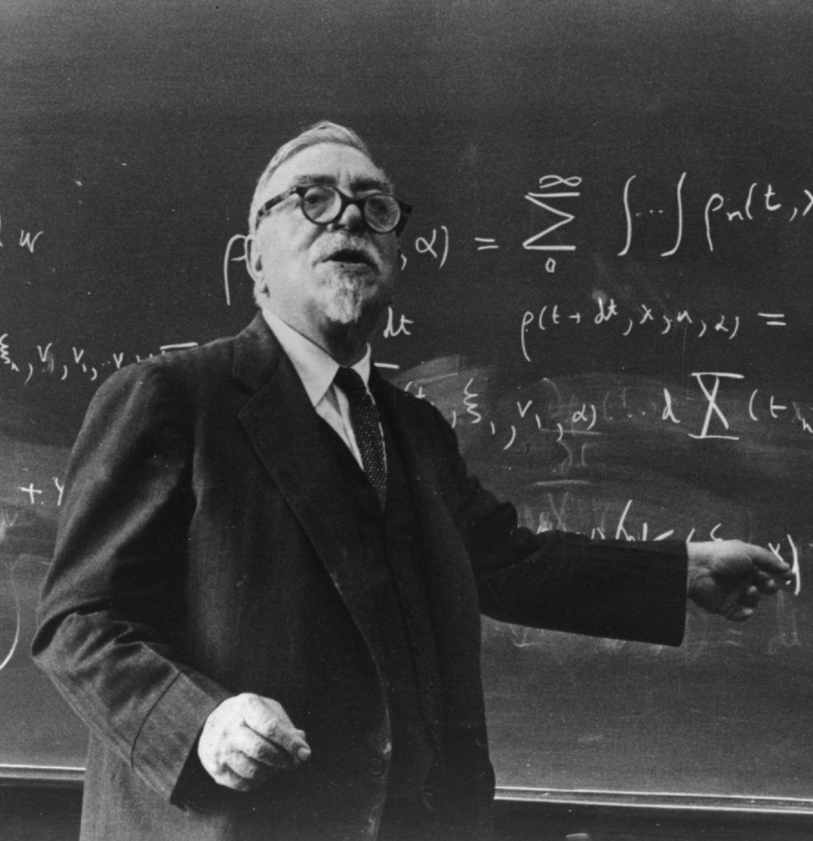
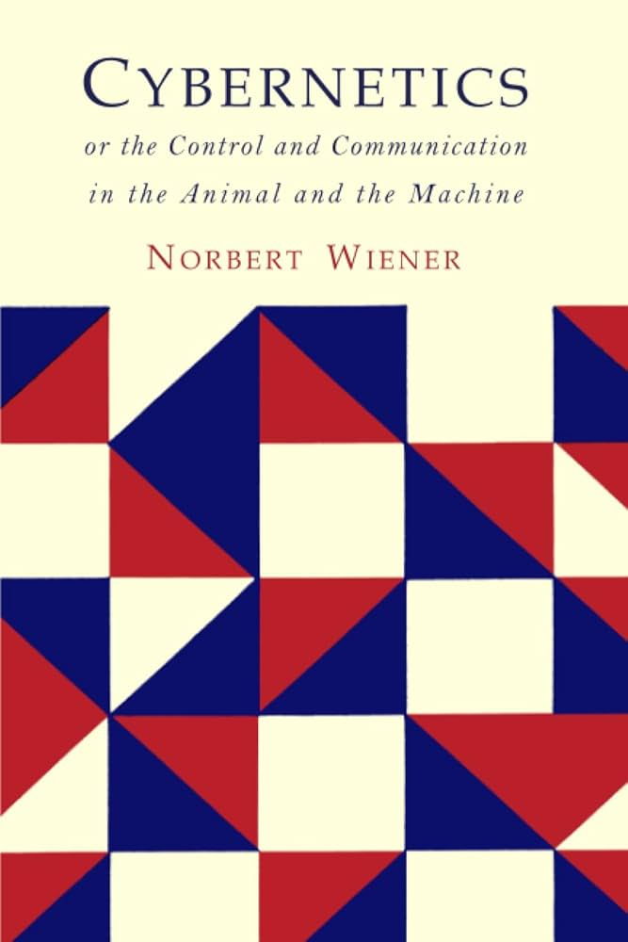
Norbert Wiener and Cybernetics - 1940’s
Coined the term Cybernetics in 1948 with his book Cybernetics: Or Control and Communication in the Animal and the Machine
The scientific study of control and communication in animals, humans, and machines.
He presents the idea of a feedback system where a machine can adjust based on the output

Slide 17
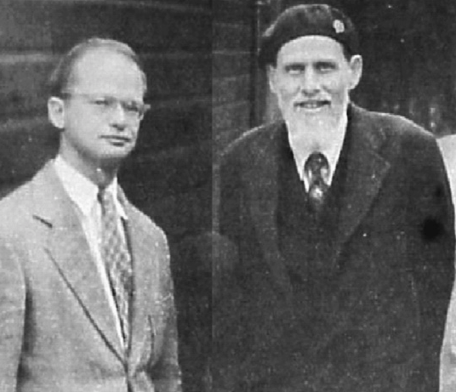
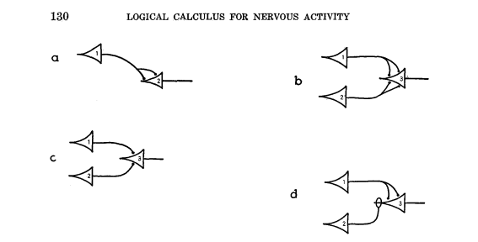
McCulloch and Pitts -1943
“A Logical Calculus of the Ideas Immanent in Nervous Activity”
Using a model of the nervous system to perform calculations
“Artificial Neurons” receive inputs, perform a weighted sum, and produce an output signal

Slide 18

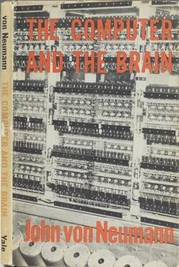
John von Neumann - 1940’s
“The most immediate observation regarding the nervous system is that its functioning is prima facie digital.”
“The basic component of this system is the nerve cell, the neuron, and the normal function of a neuron is to generate and to propagate a nerve impulse.”

Slide 19
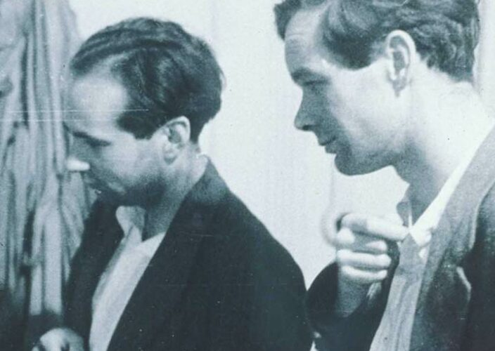
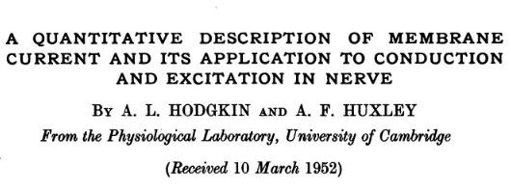
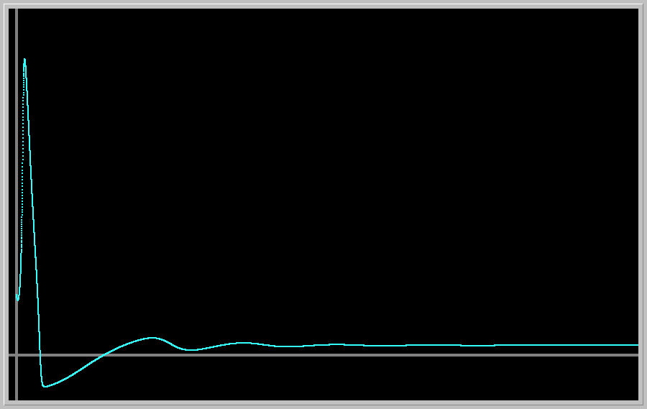
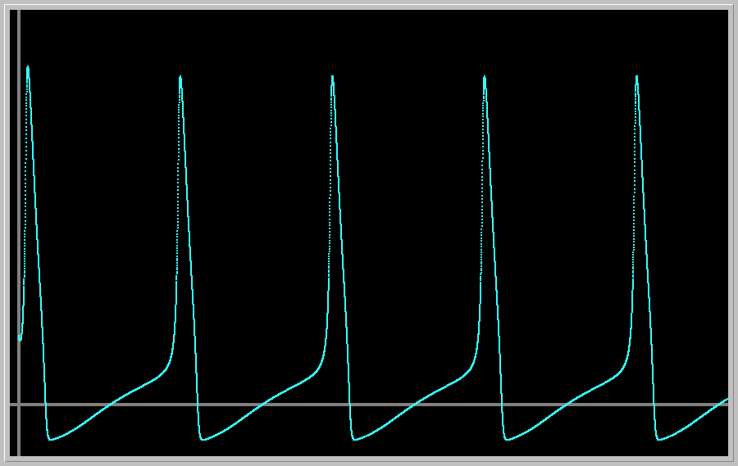
Biological Neuron - Hodgkin & Huxley - 1952
First quantitative model of neuron excitation
Awarded the 1963 Nobel Prize in Physiology or Medicine (with John Eccles)
Inspired early artificial neural networks:
Neurons can be modeled mathematically
Information is transmitted via signals

Slide 20
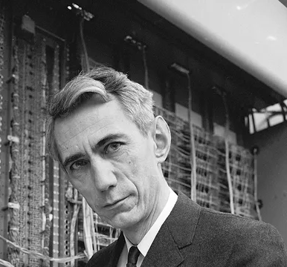
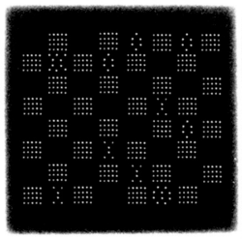
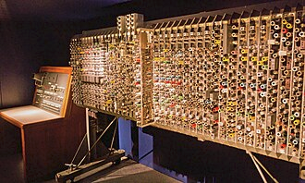
The First Video Game - 1951
Developed by Christopher Strachey in 1951
First ran on a limited construction of Alan Turing’s Automatic Computing Engine (Pilot ACE)

Slide 21
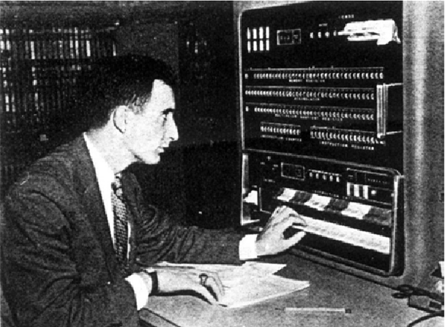
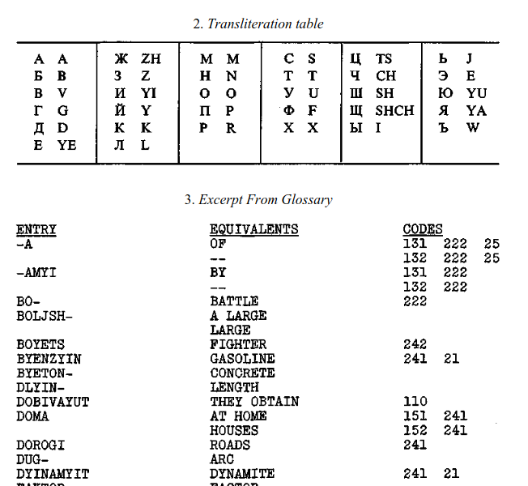
Machine Translation - 1954
A public demonstration of a Russian-English machine translation system
A collaboration between IBM and Georgetown University
First major Machine Translation demo
Translated 60 Russian sentences into English using a small vocabulary and hand-crafted rules

Slide 22
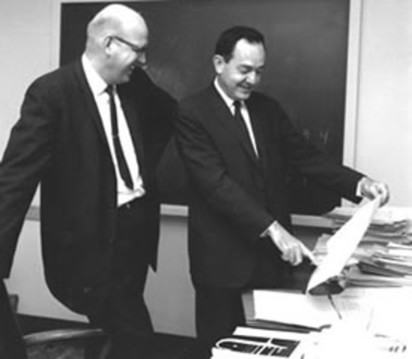
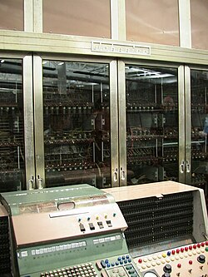
Logic Theorist - 1955
Herbert Simon Allen Newell and John Clifford Shaw - Logic Theorist
Considered the first AI program.
Designed to prove mathematical theorems
Used heuristic search to mimic human problem-solving
Program ran on the JOHNNIAC computer at the RAND Corporation

Slide 23
Early AI Conferences
Macy Conferences 1946 - 1953
Paris Conference 1951
Ratio Club 1949 - 1958
Dartmouth 1956

Slide 24
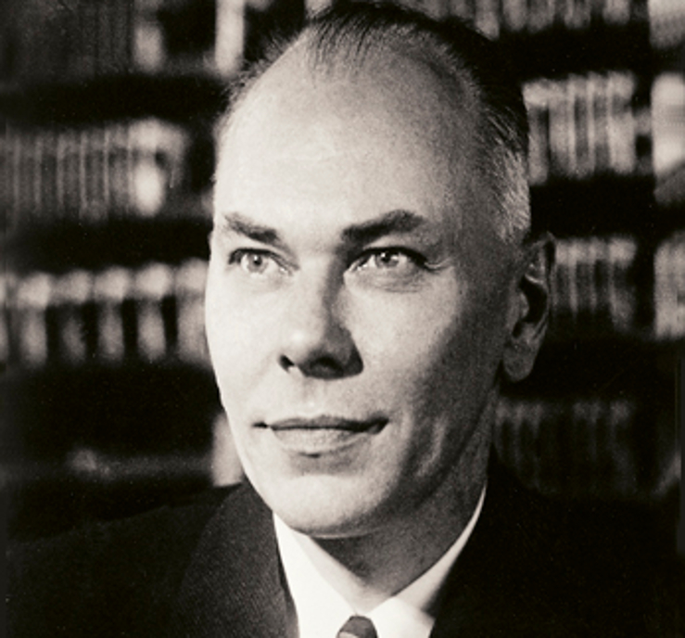
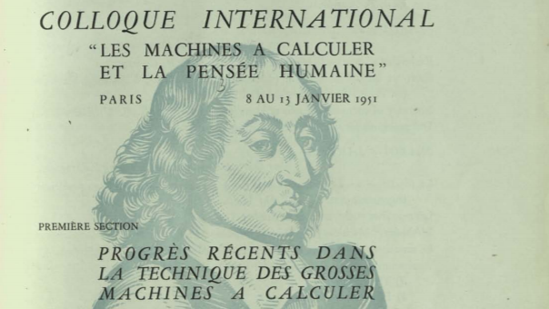
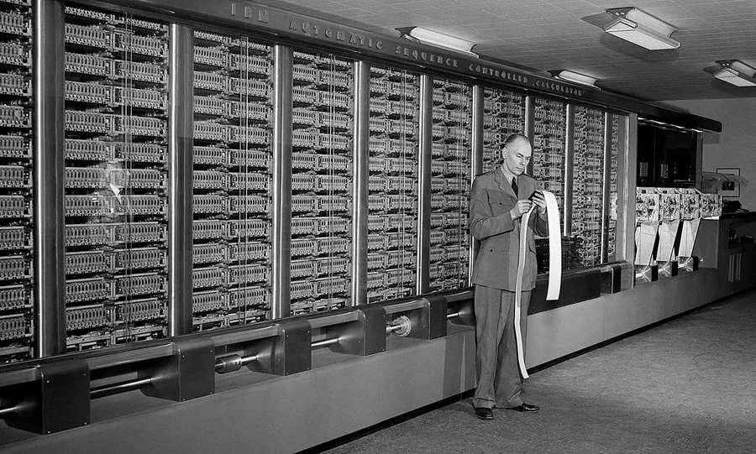
Early Cybernetics Conferences
Macy Conferences 1946-1953
Series of 10 conferences held mostly in New York City
Goal: foundations for a general science of the workings of the human mind
Paris Conference 1951
Large Calculating Machines
Mathematics and Applied Science Relevant to Large Machines
Large Machines, Logic, and the Physiology of the Nervous System

Slide 25
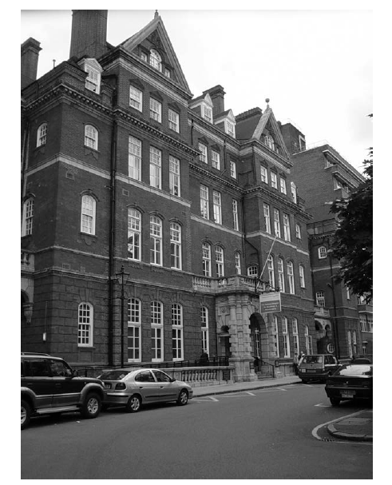
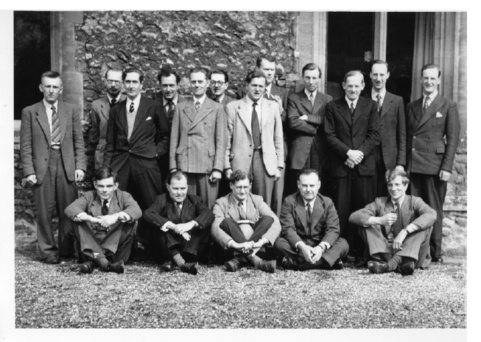
Ratio Club 1949 - 1958
British dining club
Young psychiatrists, psychologists, physiologists, mathematicians and engineers
Discuss issues in cybernetics.
McCulloch gave the first lecture.
Turing presented two lectures on his famous papers.
UK challenge to Wiener conferences

Slide 26

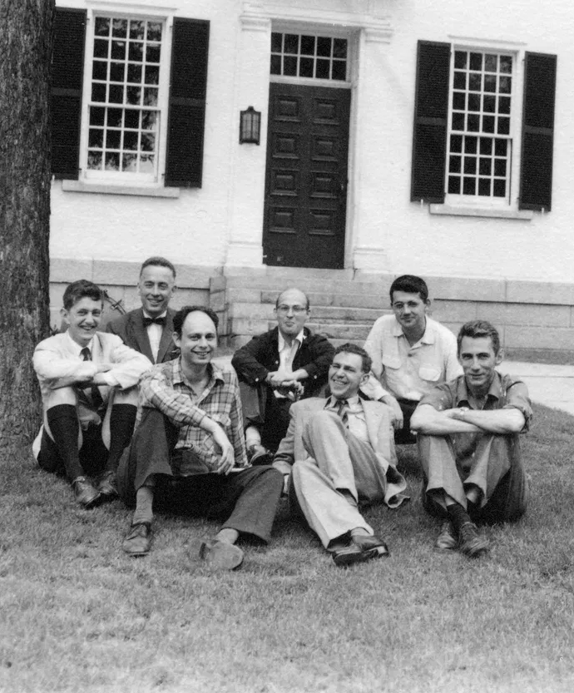
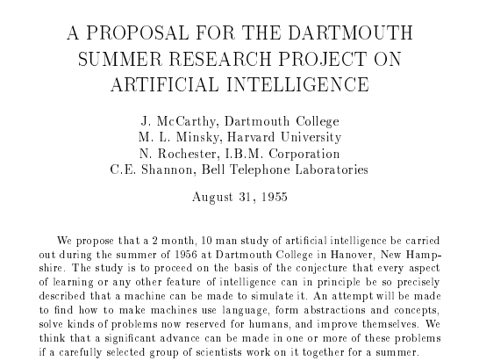
The Dartmouth Workshop– 1956

Slide 27
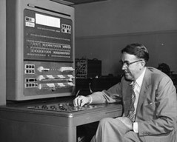
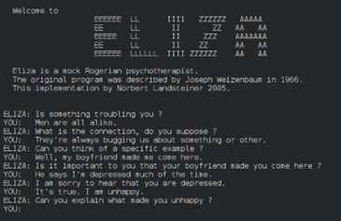


Trends in AI
AI in Games
AI in Mathematics
AI in Language
AI Architecture

Slide 28
AI in Games
AI in Games
AI in Mathematics
AI in Language
AI Architecture
“Genetics researchers have fruit flies. Oncologists have white mice. For pioneering computer scientists studying artificial intelligence, it was games” - IBM

Slide 29


AI in Games - Checkers 1959
Arthur Samuel from IBM developed Samuel Checkers which improved by playing games against itself.
Samuel called this process “machine learning.”

Slide 30


AI in Games– Chess 1997
IBM’s Deep Blue defeated World Chess Champion Garry Kasparov
“I could feel—I could smell—a new kind of intelligence across the table.” - Garry Kasparov

Slide 31


AI in Games – Jeopardy! 2011
IBM’s Watson DeepQA, ushered in a new era in natural language processing as the Jeopardy! champion
Hallucination (confabulation):
“What is Toronto?????”
“‘Quiz show contestant’ may be the first job made redundant by Watson, but I’m sure it won’t be the last.” - Ken Jennings, Jeopardy Host

Slide 32


AI in Games– Go 2016
Go vs Chess: 10^170 vs 10^47
Google’s AlphaGo defeats a Go World Champion
Used Supervised and Reinforcement Learning
“I feel like his moves were from an alien intelligence.” - Lee Sedol Go Champion

Slide 33
AI in Mathematics
AI in Games
AI in Mathematics
AI in Language
AI Architecture
“I think in three years AI will become useful for mathematicians. It will be a great co-pilot. You’re trying to prove a theorem, and there’s one step that you think is true, but you can’t quite see how it’s true. And you can say, ‘AI, can you do this stuff for me?’ And it may say, ‘I think I can prove this” - Terence Tao October 2024

Slide 34

Logic Theorist - 1955
Herbert Simon Allen Newell and John Clifford Shaw - Logic Theorist
Proved theorems in Principia Mathematica:
Theorem 2.85 ((P∨Q)⇒(P∨R))⇒(P∨(Q⇒R))

Slide 35


Symbolic AI
Symbolic Automatic Integrator (SAINT) (1961):
Developed by James Slagle
Solved problems typically found in first-year calculus courses
Macsyma, Mathematica, Maple,
Sage
Automated Theorem Provers
Rocq, PVS, Issible, Mizar, E…
Used for verifying Microprocessor Designs and Certifying Compilers

Slide 36




Proof Assistants
Rocq
Proved 4 Color Theorem
LEAN
Real Analysis book by Terence Tao

Slide 37



Google Deepmind -
AlphaProof and AlphaGeometry: Combines Symbolic AI with AlphaZero
Silver-medal in International Mathematical Olympiad

Slide 38


Formalizing Fermat's Last Theorem in Lean: A Landmark Mathematical Project
1637
1995

Slide 39
AI in Language
AI in Games
AI in Mathematics
AI in Language
AI Architecture
“We do not have useful machine translation, and there is no immediate or predictable prospect of useful machine translation” - ALPAC Report 1966

Slide 40
Machine Translation - 1954
A public demonstration of a Russian-English machine translation system
A collaboration between IBM and Georgetown University
First major Machine Translation demo
Translated 60 Russian sentences into English using a small vocabulary and hand-crafted rules

Slide 41


ELIZA: AI Chatbot – 1967
“ELIZA- A Computer Program for the Study of Natural Language Communication Between Man and Machine”
It is a chatbot similar to ChatGPT!
Can ask questions about psychology
Gave responses based on keywords

Slide 42


The ALPAC Report - 1966
ALPAC (Automatic Language Processing Advisory Committee) Report (1966):
Output was expensive, slow, and inaccurate.
Recommended cutting funding, halting most Machine Translation projects.
AI language research cooled during the late 1960s

Slide 43


Google Translate - 2006
Started to translate Russian to English
Utilized Statistical Machine Learning
Trained on documents from the United Nations
2016 shifted from pure statistical machine learning to neural networks (We will see the impacts of this change very shortly)

Slide 44

Virtual Assistants - 2011
2003 DARPA and Stanford Research Institute (SRI) started work on speech recognition
2007 a team of researchers leave the project to start their own start-up called Siri
2010 Siri is acquired by Apple
2011 Siri is integrated into the iPhone 4s
Google (Google Now), Microsoft (Cortana), Amazon (Alexa)

Slide 45
AI Architecture
AI in Games
AI in Mathematics
AI in Language
AI Architecture
“Deep learning is a way of teaching computers to represent the world, so they can understand it.” - Yann LeCun

Slide 46



Rosenblatt and The Perceptron – 1957
Based on work by McCulloch and Pitts “Artificial Neuron”
Three Components:
Sensory units - receive optical input
Association units - fire based on input from the sensory units
Response units- fire based on input from association units

Slide 47

Minsky and The Perceptron – 1969
“Perceptron” Marvin Minsky and Seymour Papert Perceptron (1969)
They showed that the Perceptron had significant weaknesses (XOR Problem)
Training the Perceptron was impractical for many real problems

Slide 48


Backpropagation – 1980’s
Efficient computational technique training a Neural Network
Rosenblatt observed a need for backpropagation (1962)
Seppo Linnainmaa"reverse mode of automatic differentiation" (1970)
Paul Werbos applied backpropagation to MLP (1982)
Rumelhart, Hinton, and Williams publish their backpropagation method (1986)
LeNet 1989 - Digit Recognition

Slide 49


Universal Approximation Theorems
Proved by George Cybenko and Kurt Hornik (1989)
A feed-forward neural network with a single hidden layer and a non-linear activation function can approximate any continuous function to an arbitrary degree of accuracy
Subsequent proofs have generalized to other types of networks

Slide 50


Hardware and Data
Moore's Law - Computing power doubles every 2 years
1990 600nm vs 2025 ~2nm
GPU (Graphics Processing Unit)
Internet
Large Number of Parameters (GPT4 167B)
Training Costs (~100M 2023)
AI Data Centers

Slide 51

Deep Learning – 2010’s
Neural networks with several hidden layers
Recurrent Neural Networks (RNNs) / Long Short-Term Memory (LSTM) (Late 1980s / 1997): Process sequential data in text and speech.
AlexNet (2012): Applied neural networks to large-scale image recognition with “Convolutions”
Generative Adversarial Networks (GANs) (2014): Generate data, such as images.
ResNet (2015): Residual connections, more complex connections within the network

Slide 52


The Transformer – Late 2010’s
“Neural Machine Translation by Jointly Learning to Align and Translate” (2014)
The Attention Mechanism focuses on important parts of the input
“Attention is All You Need” (2017)
The transformer allows for parallel attention
Titan Transformer (2025)
Notes:
2014: https://arxiv.org/abs/1409.0473
2017 Attention is all you Need: https://arxiv.org/abs/1706.03762
2018 BERT: https://arxiv.org/abs/1810.04805
2020 VIT: https://arxiv.org/abs/2010.11929
Before Transformers
NLP dominated by:
RNNs (Recurrent Neural Networks) & LSTMs (Long Short-Term Memory) → good for sequences, but slow to train and hard to parallelize.
CNNs for NLP in some tasks, but limited context handling.
Limitations:
Sequential processing → can’t parallelize across tokens efficiently.
Long-range dependencies hard to capture — context “fades” over distance.
Attention Is All You Need (Vaswani et al., 2017, Google)
Key idea: drop recurrence entirely → rely solely on attention mechanisms.
Self-Attention:
For each word/token, compute its relationship (“attention weight”) to every other token in the sequence.
Captures long-range dependencies directly — no “forgetting” like in RNNs.
Multi-Head Attention:
Runs multiple attention operations in parallel → captures different types of relationships (syntax, semantics, etc.).
Positional Encoding:
Since the model has no recurrence, adds a vector to each token embedding indicating its position in the sequence.
Advantages
Parallelism: All tokens processed simultaneously → huge speed-up on GPUs/TPUs.
Scalability: Can handle much larger datasets & models without bottlenecking.
Better Context Handling: Long sentences, paragraphs, even documents can be processed with meaningful relationships maintained.
Impact
Set new state-of-the-art results in machine translation → faster and more accurate than RNN-based seq2seq.
Quickly adopted in:
BERT (2018) – bidirectional Transformer for understanding tasks.
GPT (2018–present) – autoregressive Transformer for generation tasks.
Vision Transformers (ViT, 2020) – applying attention to images.
Became the default architecture for NLP and beyond.
Symbolic vs. Statistical Context
Purely statistical/deep learning — no explicit linguistic rules.
Success fueled the dominance of large-scale neural architectures over hybrid symbolic approaches in most NLP research.
Fun Facts
The title Attention Is All You Need was a playful jab at the complexity of earlier models — but turned out to be historically accurate for many tasks.
Early Transformer models had far fewer parameters (~65M) compared to modern LLMs, yet still transformed NLP performance.

Slide 53







The Large Language Model – 2020’s
AI trained on large amounts of text to generate and understand human-like language
GPT-1 (2018)
GPT-3.5 (2022) - First Public Release
ChatGPT, Copilot, Gemini, Grok, Claude, Llama, Deepseek, and many more

Slide 54












Turing Award Winners for AI
1969 Marvin Minsky
1971 John McCarthy
1975 Allen Newell and Herbert Simon
1994 Edward Feigenbaum Raj Reddy
2011 Judea Pearl
2018 Yoshua Bengio, Geoffrey Hinton, Yann LeCun
2024 Andrew Barto, Richard S. Sutton

Slide 55







Nobel Prize Winners for AI
1978 Herbert Simon (Economics)
2024 Geoffrey Hinton, John J. Hopfield (Physics)
2024 David Baker, Demis Hassabis, John Jumper (Chemistry)

Slide 56


Future of AI - C3PO or Hal 9000
Hassabis: Optimistic Outlook
Hinton: Cautious Outlook
Productivity Gains
Transforms Science and Medicine
Faster Drug Development
Cross Field Expertise
Better Medical Care
P (doom) - AI Take Over
“Bad Actors Using AI for Bad Things”
Cyberattacks
Create new weapons
Manipulate Elections

Slide 57


Race for AI Dominance
“The United States must not only lead in developing general-purpose and frontier AI capabilities, but also ensure that American AI technologies, standards, and governance models are adopted worldwide to strengthen relationships with our allies and secure our continued technological dominance.” - Promoting the Export of The American AI Technology Stack (2025)
“By 2030, China’s AI theories, technologies, and applications should achieve world-leading levels, making China the world’s primary AI innovation center, achieving visible results in intelligent economy and intelligent society applications, and laying an important foundation for becoming a leading innovation-style nation” - New Generation Artificial Intelligence Development Plan (2017)

Slide 58

From Hinton’s Nobel Banquet Speech
There is also a longer term existential threat that will arise when we create digital beings that are more intelligent than ourselves. We have no idea whether we can stay in control. But we now have evidence that if they are created by companies motivated by short-term profits, our safety will not be the top priority. We urgently need research on how to prevent these new beings from wanting to take control. They are no longer science fiction.

Slide 59
Acknowledgements and References
We want to thank all of those who helped contribute to this presentation with special thanks to:
Burt Rosenberg
Vanessa Aguiar-Pulido
Odelia Schwartz
Dilip Sarkar
References are available in the slide notes or upon request

